Slide 1



RETAIL INNOVATION
Reducing Long Queues
in Stores
A Design Thinking Approach to
Optimizing Customer Experience
Case Study for Students & Professors
Methodology: Empathize • Define • Ideate • Prototype • Test

Slide 2



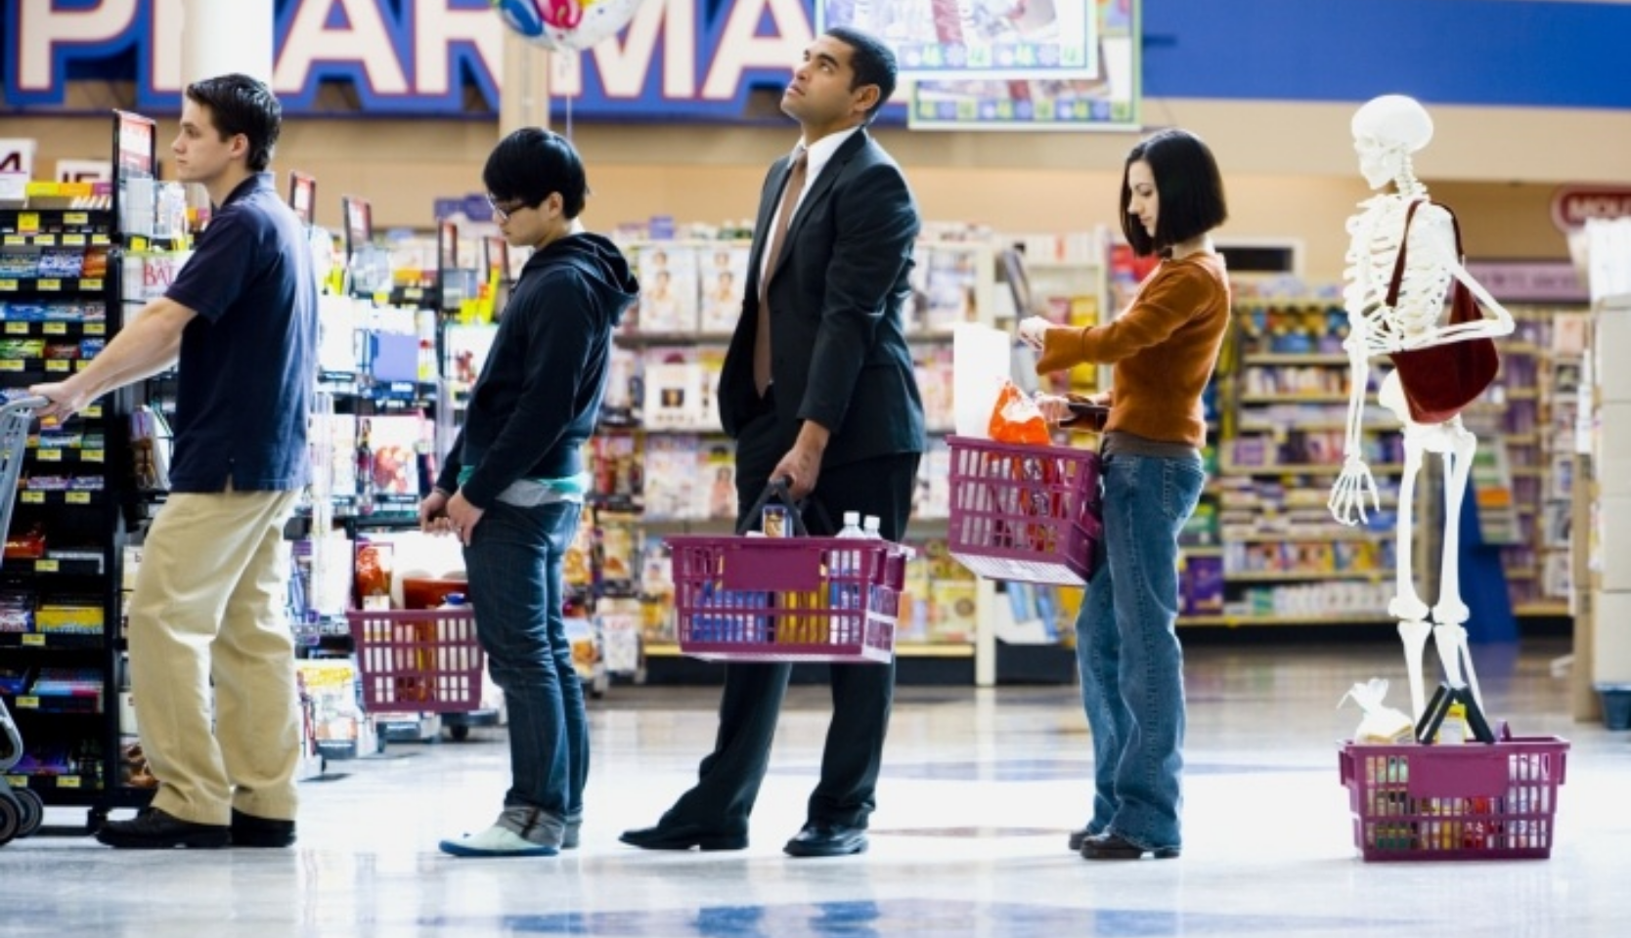





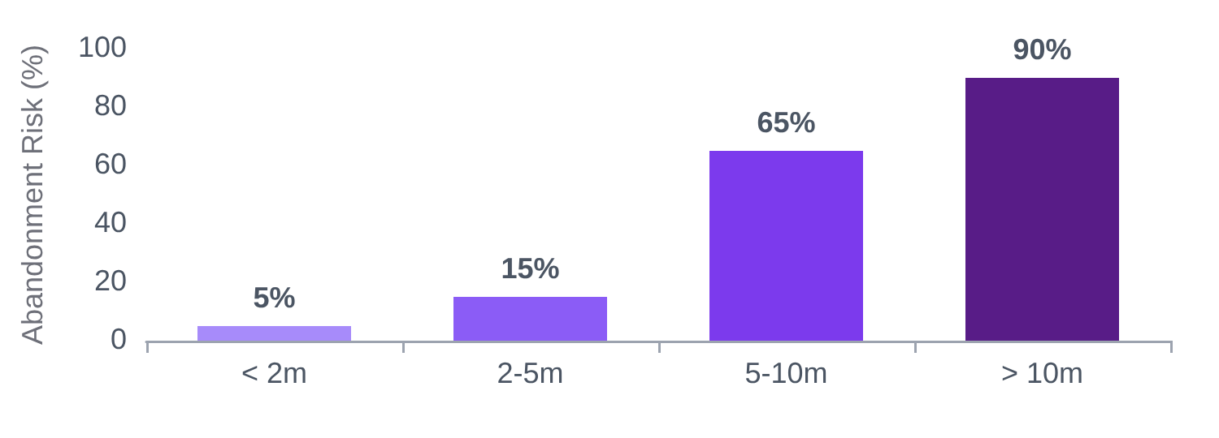

Problem Overview
The global challenge of retail congestion and its business impact.
Global Retail Issue
A widespread problem affecting stores worldwide, damaging customer loyalty across all sectors.
Customer Frustration
Wasted time leads to irritation, stress, and a significantly poor shopping experience.
Lost Sales Revenue
Businesses face immediate financial loss when customers abandon full carts due to wait times.
CART ABANDONMENT RISK BY WAIT TIME
The 5–10 Minute Rule
Studies show that the majority of customers will abandon their purchases after just 5 to 10 minutes of waiting in line.

Slide 3



















STAGE 01
Empathize
Understanding the human experience behind the queue.
Customer Experience
Staff Perspective
Feelings of boredom, irritation, and stress during long waits.
Feeling overwhelmed and pressured during high-traffic rush hours.
High frustration for time-sensitive shoppers and commuters.
Stress from limited manpower managing surge capacity.
Significant challenges for parents with children in confined lines.
Intense burnout during peak periods (lunch, weekends, holidays).
OBSERVATION & RESEARCH METHODS
User Interviews
Direct Observations
Feedback Surveys

Slide 4




















User Pain Points
Critical friction areas identified from the empathy research phase.
Long Waiting Time
Poor Experience
Cart Abandonment
Average of 10–20 minutes during peak hours, leading to significant customer friction.
The checkout process ruins the overall shopping journey, leaving a negative lasting impression.
High percentage of customers leave items and walk out without purchasing due to queue length.
Lower Loyalty
Inefficient Flow
Staff Overload
Customers rate the store poorly and are less likely to return, decreasing lifetime value.
Manual scanning is slow, error-prone, and creates a bottleneck in the store operations.
High pressure on limited staff during rush hours leads to burnout and errors.
Insight: The bottleneck is manual processing, not just the number of open counters.
Design Thinking: Empathize Phase

Slide 5












PHASE 2
Define
Synthesizing research into a actionable problem statement.
THE PROBLEM STATEMENT
"Customers experience significant delays and frustration due to
inefficient, manual checkout systems
in retail stores, leading to cart abandonment, reduced satisfaction, and lost revenue for businesses."
Root Cause
Opportunity Gap
Dual Impact
The primary bottleneck is identified as the manual scanning process at checkout counters.
Modern technology remains under-leveraged in traditional retail checkout environments.
The problem negatively impacts both the customer experience and the store owner's bottom line.
DESIGN THINKING FRAMEWORK • PROBLEM DEFINITION STAGE

Slide 6

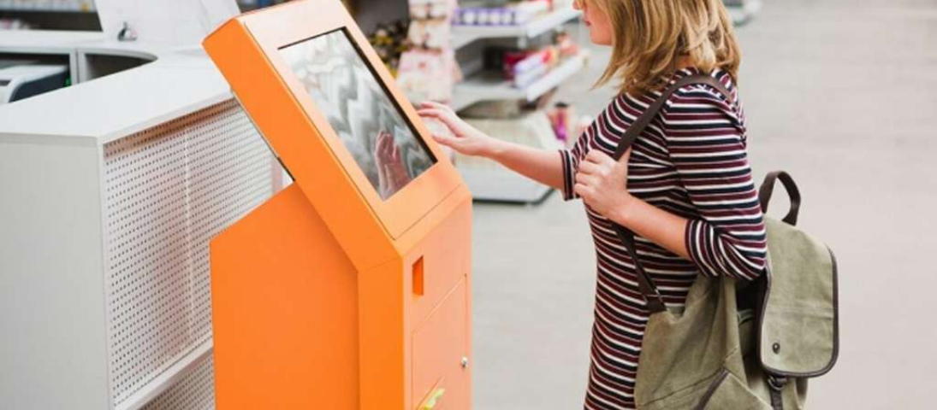













PHASE 3: IDEATION
Brainstorming Solutions
"What if the queue wasn't a line, but an experience?"
MOST FLEXIBLE
Self-Checkout Kiosks
Mobile Scan & Pay
Virtual Queue Tokens
• Dedicated physical stations
• Scan items via smartphone app
• Digital queuing via SMS/App
• Customer-led scanning & payment
• Digital wallet integration
• Browse while waiting
• Proven at Walmart, IKEA, etc.
• Zero physical checkout lines
• Reduces physical floor crowding
INSIGHT
Ideation focused on reducing the manual checkout bottleneck while leveraging existing technology.

Slide 7


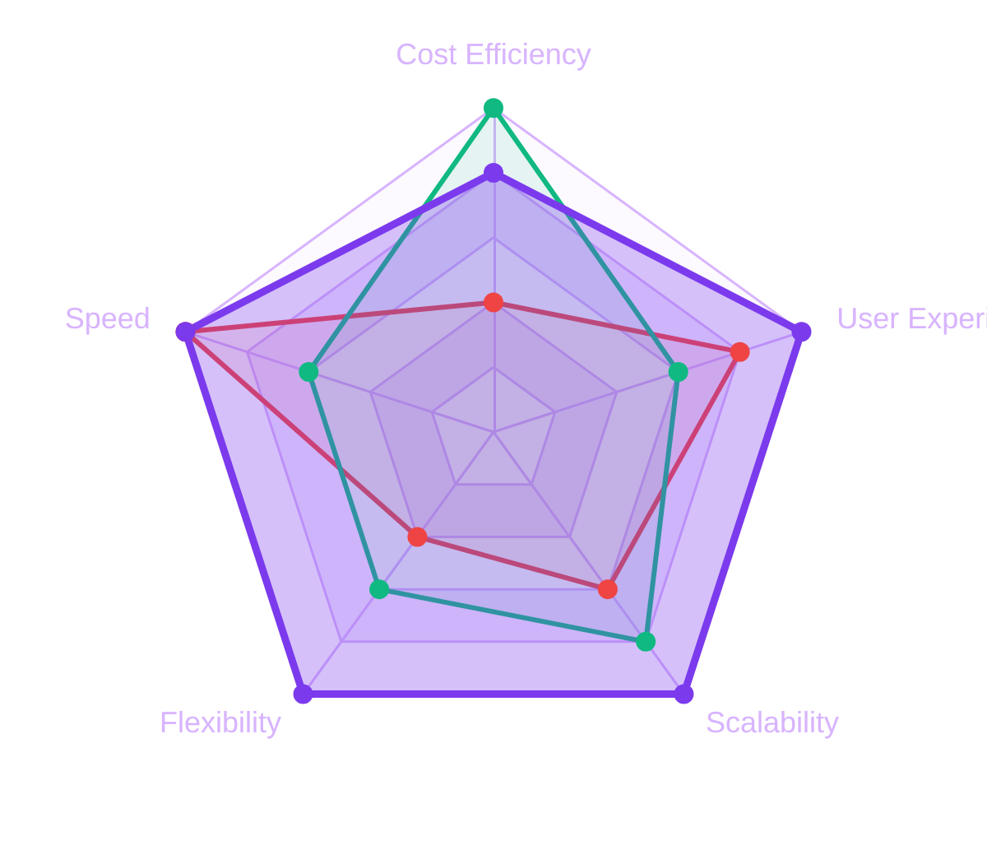










Solution Comparison
Evaluating the best fit based on efficiency, cost, and scalability.
Solution
Cost
Speed
Key Benefit
PERFORMANCE MATRIX
Self-Checkout Kiosks
Independent scanning & payment
High
High
Virtual Queue Token
Reduces physical crowding
Low
Medium
Mobile Scan & Pay
Skips queues entirely
Medium
Very High
Optimal Choice: Mobile Scan & Pay
Best balance of speed, cost, and user flexibility.
*Chart based on internal evaluation of Cost Efficiency, Processing Speed, and Solution Flexibility.

Slide 8














Proposed Solution: Mobile Scan & Pay
A seamless digital bridge between physical shopping and instant checkout.
Real-time Scanning
Scan product barcodes instantly using your phone camera.
One-Tap Digital Payment
Secure payment via UPI, Credit Cards, or Mobile Wallets.
"Transforming the smartphone into a personal checkout counter."
Skip the Queue
Walk out after payment—no waiting at traditional counters.
IMPACT GOAL
INDUSTRY BENCHMARKS
Checkout time reduced to under 2 minutes
Amazon Go
Walmart Scan & Go
|
|
IKEA Scan

Slide 9


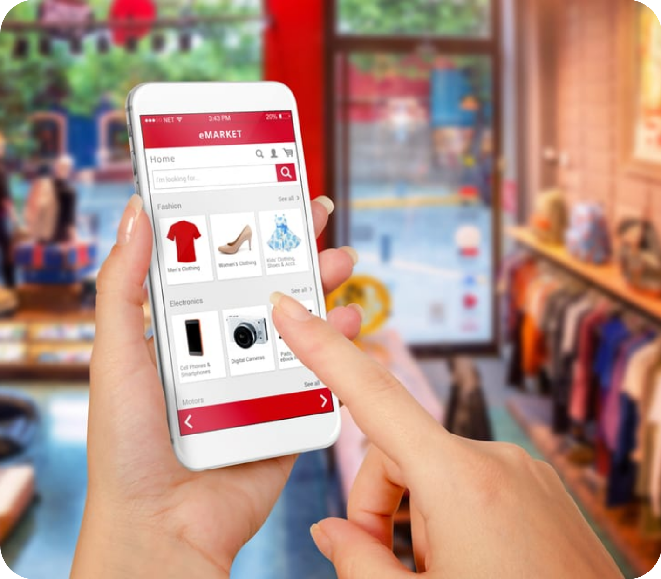



















PHASE 4: PROTOTYPE
App Core Features
Barcode Scanner
Digital Cart
High-speed camera integration for instant product identification.
Real-time summary of items, quantities, and total price.
Digital Payment
Queue Tracker
Integrated UPI, cards, and mobile wallets for one-tap checkout.
Live updates on store congestion and checkout wait times.
"User-centric interface designed for rapid scanning and seamless payment."
UI Design Philosophy
Simple, clean interface with large accessibility-focused touch targets.
One-Tap Flow
Real-time Sync
Digital Receipt
Notifications
Instant SMS/Email confirmation.
Smart alerts for offers & exit.

Slide 10















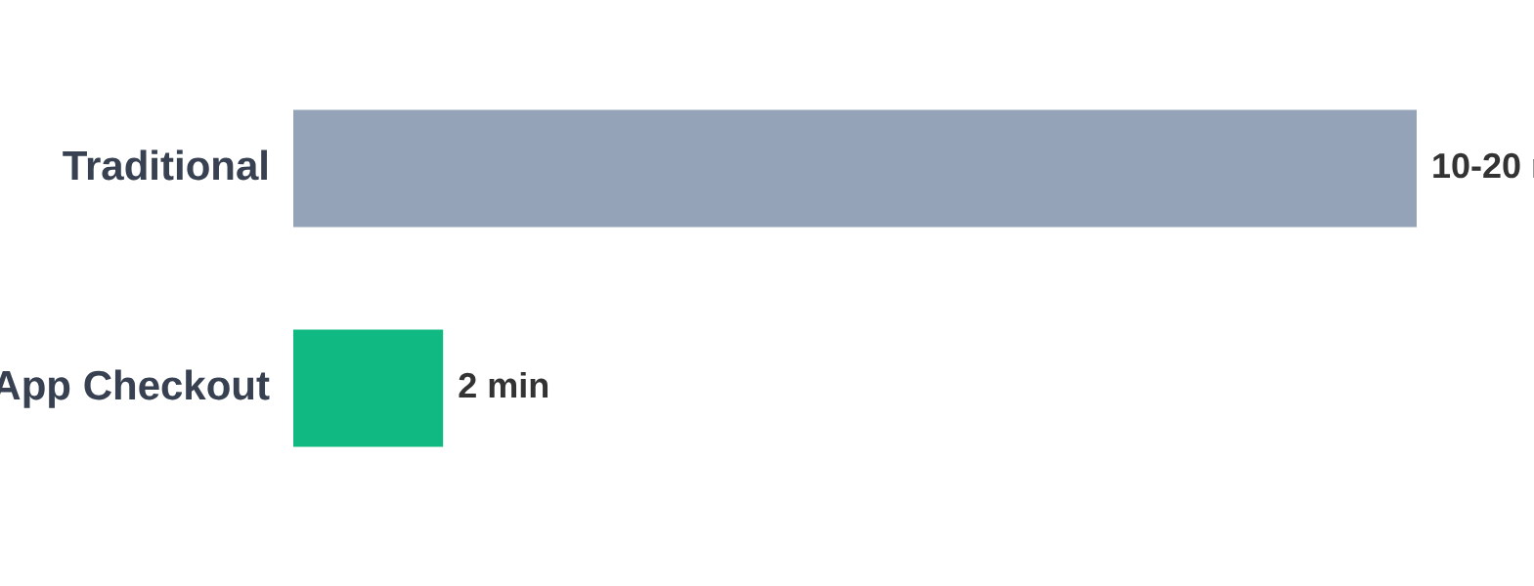
User Journey
A seamless end-to-end shopping experience powered by Scan & Pay technology.
STEP 01
STEP 02
STEP 03
STEP 04
STEP 05
STEP 06
STEP 07
Enter Store
Open App
Scan Items
Review Cart
Pay Instantly
Exit Store
Get Receipt
CHECKOUT DURATION COMPARISON (MINUTES)
80% Faster
Dramatic Time Savings
By eliminating the physical queue bottleneck, the total checkout time is reduced from an average of 10-20 minutes to under 2 minutes.

Slide 11






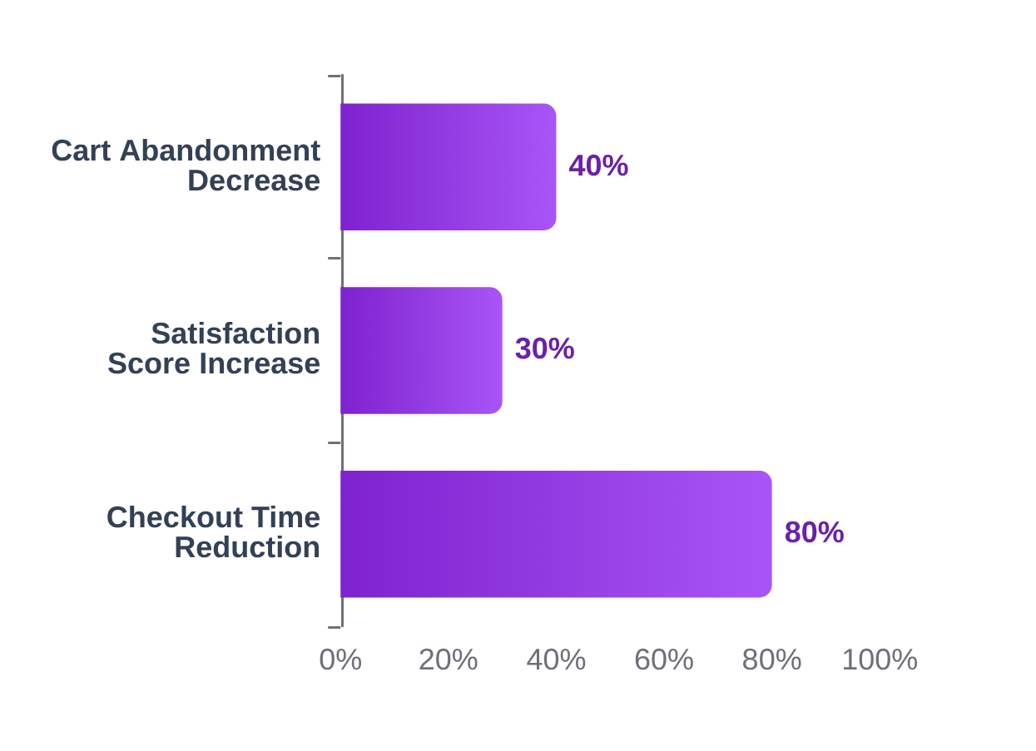





Testing & Feedback
PHASE 05: TEST
Key Performance Indicators
Expected Improvement Metrics
TIME REDUCTION
USER SATISFACTION
Target: 80% Reduction
NPS & In-app Feedback
Validation Strategy
1
Pilot Launch: Single store deployment for real-world stress testing.
2
A/B Testing: App users vs. traditional checkout performance comparison.
3
Qualitative Feedback: In-depth user interviews post-experience.
"Initial results indicate a significant shift in retail efficiency and customer retention."

Slide 12




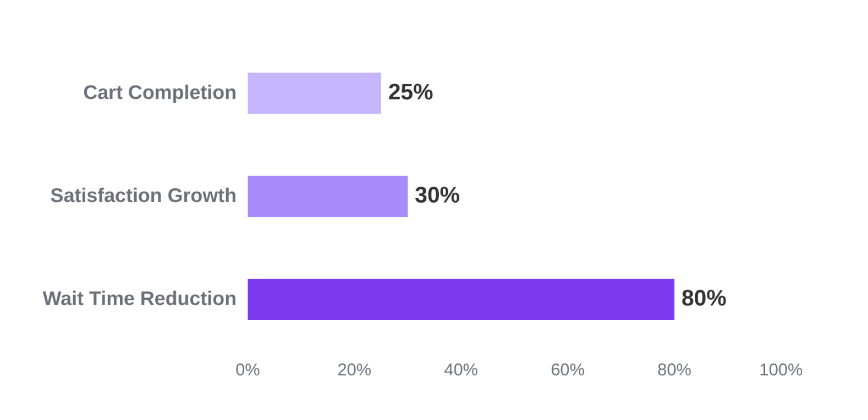




Conclusion & Impact
Transforming retail through user-centric innovation and technology.
Strategic Insight
PROJECTED PERFORMANCE GAINS
Design Thinking identified the root cause as manual bottlenecks, not just physical line length.
Scalable Solution
The Mobile Scan & Pay App offers a cost-effective, future-ready model for any retail format.
Human Impact
Empowers staff to focus on high-value customer service instead of repetitive manual scanning.
"Smarter shopping, faster checkout — one scan at a time."

